Slide 1
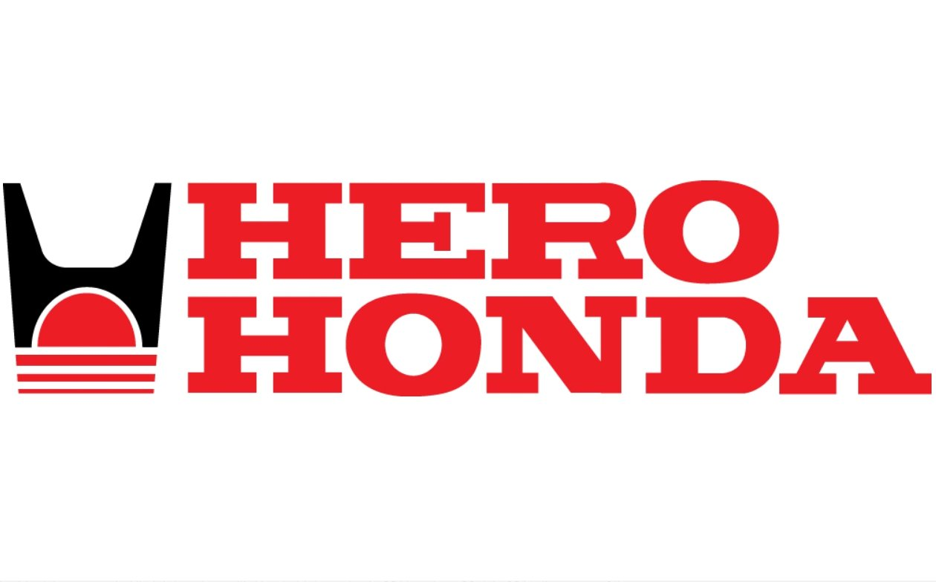
(1984-2010)
JOINT VENTURE BY HERO CYCLES & HONDA MOTOR COMPANY

Slide 2

HISTORY OF HERO
1944
In 1944 Munjal brother started hero group for supply of bicycle components in Amritsar.
1956
They moved to Ludhiana in 1956 and started hero cycle .
1975
By 1975 they become largest bicycle manufacturer in India.

Slide 3
History Of Honda Motor Company
The engineer Honda Soichiro founded the Honda Technical Research Institute near Hamamatsu in 1946 to develop small, efficient internal-combustion engines. It was incorporated as Honda Motor Company in 1948 and began producing motorcycles in 1949.
Honda has been the world's largest motorcycle manufacturer since 1959.
1964 one out of every two motorcycles sold in us is a Honda.

Slide 4
MARKET BOFORE JOINT VENTURE
The license that existed prior to economic liberalization in India did not allow foreign companies to enter the market.
In mid-80’s when the government started permitting foreign companies to enter market through minority joint ventures.

Slide 5
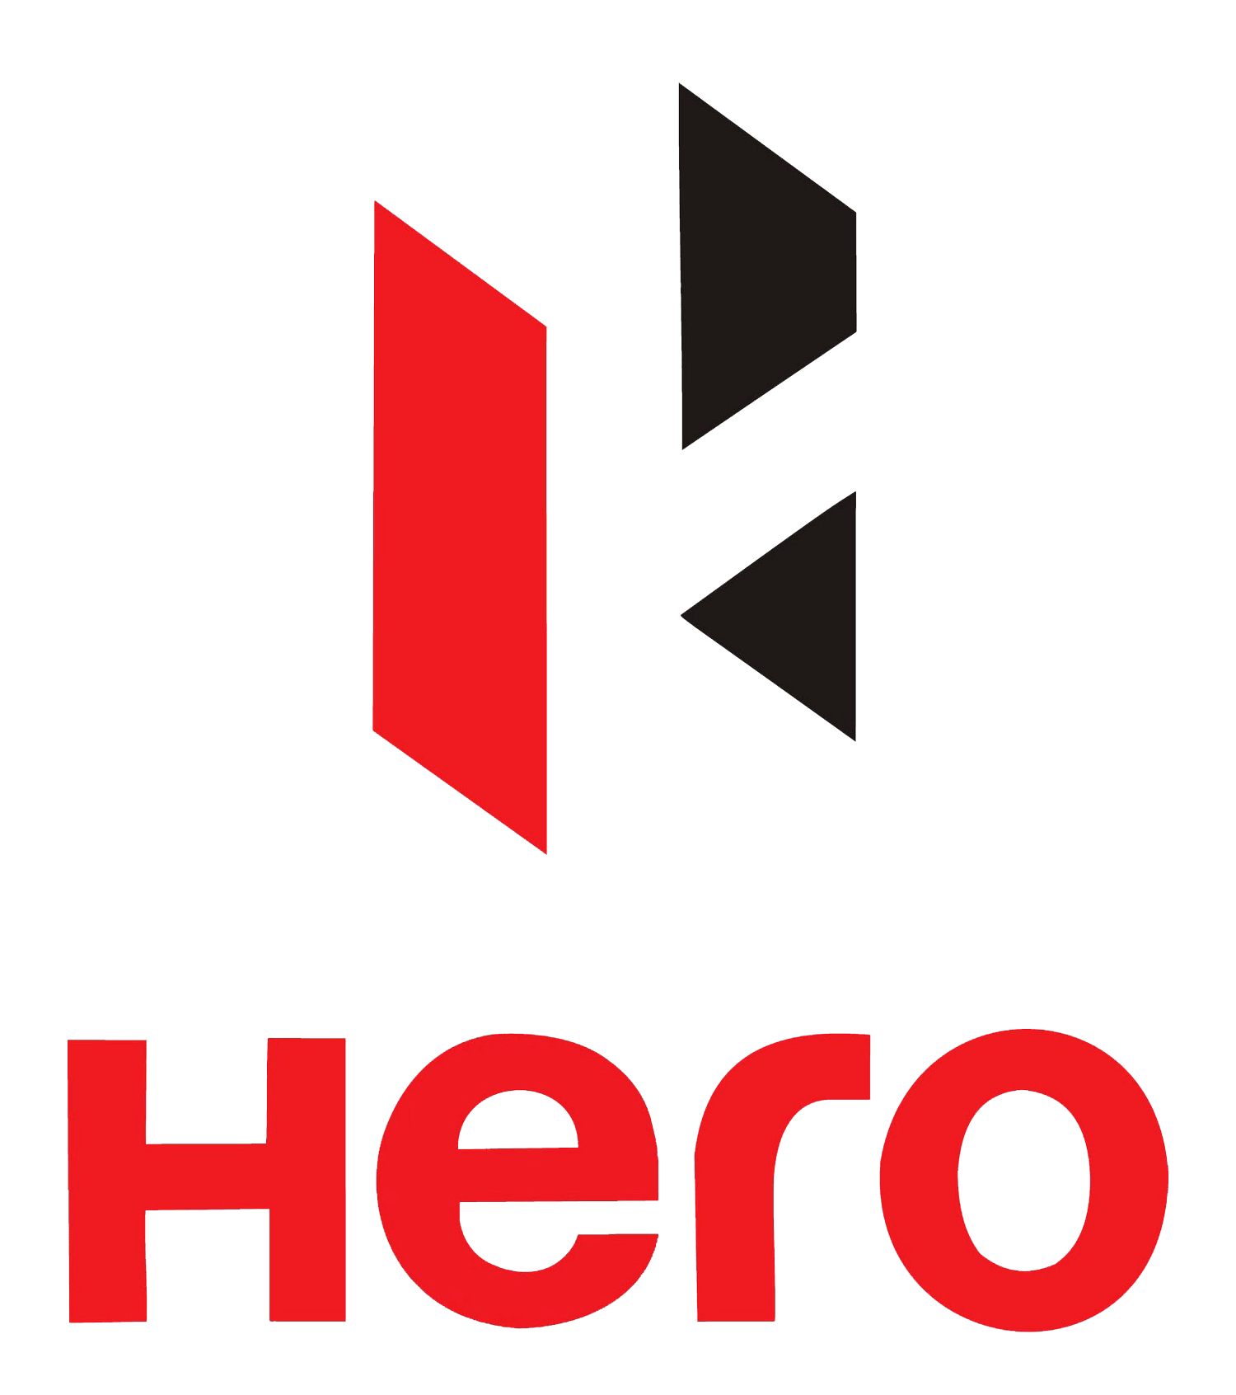
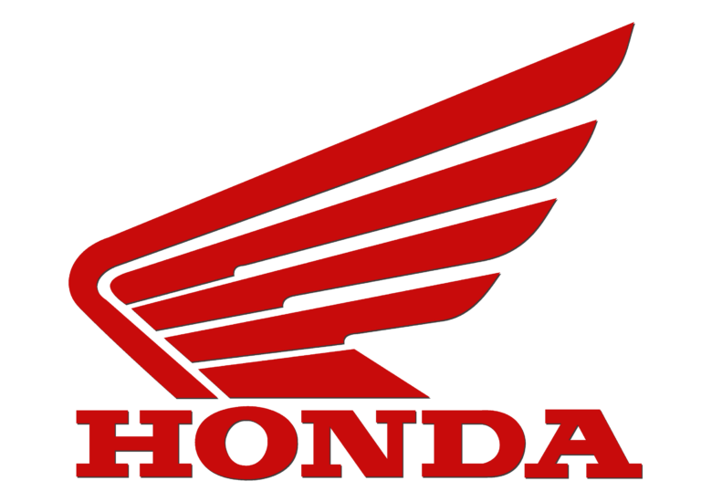
Why they come together
Access to a new technology and process.
Opportunity of large revenue.
Want to enter in Indian market but government restriction.
Access of large local distribution channels.

Slide 6
The Deal
Honda agreed to provide technology and setting up manufacturing facilities and r & d efforts.
Honda agreed for a lump sum fee of $5,00,000 and 4% royalty on sp.
Both partners held 26% of the equity with other 26% sold to public and the rest held to financial institutions.

Slide 7
VISION OF Joint Venture
Hero Honda came with the vision “ to offer highest quality at a reasonable price to meet the customer’s expectations and to exceed them”

Slide 8
Mission
Mission of hero Honda is to co-ordination between technology, system and human resources to produce product and service that meet the quality, performance and price aspiration of its customers.
At the same time maintain the highest standards of ethics and social responsibilities.

Slide 9
OBJECTIVE
Most fuel efficient company.
Develop appropriate product and excellent quality.
To meet the demand of market.
Undefeated position in Indian two wheeler market.
Maintain high quality and high standard.

Slide 10

ACHIEVEMENT
1985
First 100cc bike
1988
Was the no. 1 among all motorcycles in India
1991
National productivity award
1992
National safety award
2002
Fastener world established.
2006
Enter into scooter segment

Slide 11
SWOT Analysis
Strength
Weakness
Introduced first stoke bike in Indian market
Good mileage
Huge sale network
Brand image
Better service
Highest market share in two wheeler market
Less promotion
R&d department compare to other
Cost of production is higher then other companies

Slide 12
Opportunities
Threats
Large number of young population
New segment of market
Competitor
DECREASING market SHARE

Slide 13
Porter's five forces analysis
Threat of new entrants
Huge investment
Entry barrier is high
Need large selling and service network
Very low
Threat of substitute
Too many substitute are in market
High
Rivalry among competitors
Price , quality play important role
New model
High
Bargaining power of supplier
Low
Bargaining power of buyer
Competitor
High

Slide 14
SUCCESS STORY
Hero Honda motors had grown consistently, earning the title of the world largest motorcycle manufacturer with annual sales volume of over 2 million.
Every 30 seconds , someone in India buys hero Honda's top selling motorcycle – hero Honda splendor.
Company achieve 69% two wheeler market share.

Slide 15
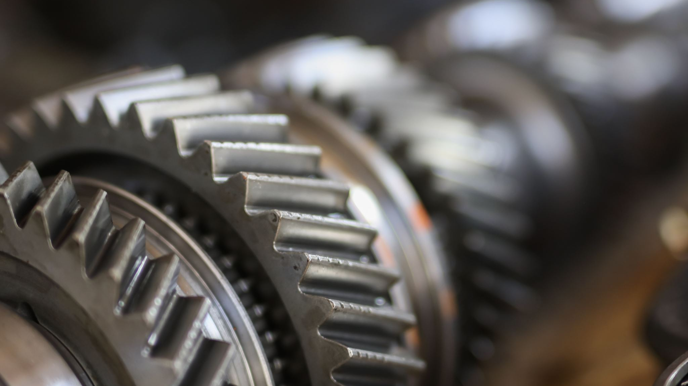
REASON BEHIND SUCCESS
Largest network of hero help in sales
Absence of competitor in starting years
Increase market of motorcycle
Better fuel efficiency
Various models
Innovative advertising

Slide 16
WHEN ISSUE STARTED
Both the companies went into a joint venture with an agreement that it was only for domestic production and consumption. As Hero Honda Motor Company was one of the largest manufacturers of two-wheelers, it wanted to expand itself by exporting to other countries. Subsequently, the agreement was modified and allowed the exports to a few countries like Nepal, Bangladesh, Sri Lanka and Columbia.
Now, Honda had its subsidiary companies in many countries. The issues arose when Hero Honda came up with exporting its motorbikes to other countries in 2008, where Honda already had its subsidiaries. Honda made a opinion that Hero Honda will have to compete on its own in the other countries because Honda could not influence its subsidiaries to import their JV’s products.

Slide 17
It was basically related to the Board Representation. The four members of the board included two executive directors who were the heads of Honda in India and Bangkok, and two other members nominated by Honda, which made the Honda Group have access to all their plans and strategies while Hero Honda did not have access to any of Honda’s plans
When the joint venture was started in 1984, it was a totally different world then, and in 2010, the visions of both the companies, Hero Honda and Honda begged to differ form each other. Hero Honda wanted to expand its business and scale it up by entering into the next growth phase by focusing on manufacturing its own products. So, it needed to invest in its own Research & development for which they had to get approval from the head office in Japan, with which Honda was not comfortable

Slide 18
Honda Motorcycles and Scooters India Pvt. Ltd. (HMSIPL) a 100% subsidiary company of Honda, entered India in 1999 which mandated the company to take a No Objection Certificate (NOC) from its existing joint venture partner, Hero Honda. The NOC was given, on a clause that Honda will not make products that would compete directly with its partner.

Slide 19
Joint Venture Broken 2010
Hero paid 2479.33 for assembly, manufacture, selling, distribution and export licenses,
Honda entered into share transfer agreement
Entire shareholding of 26% transferred to hero

